Slide 1
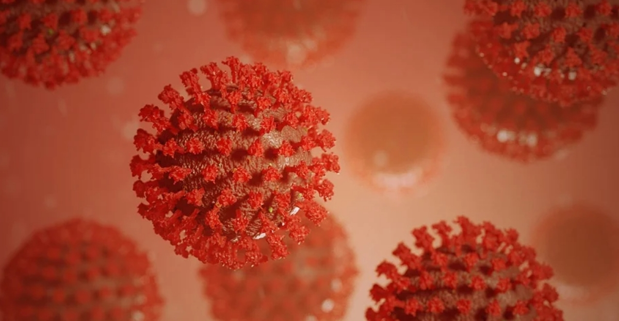
B.I.G. Summer Hack:
Modeling Covid-19

Slide 2
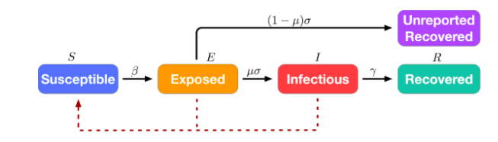
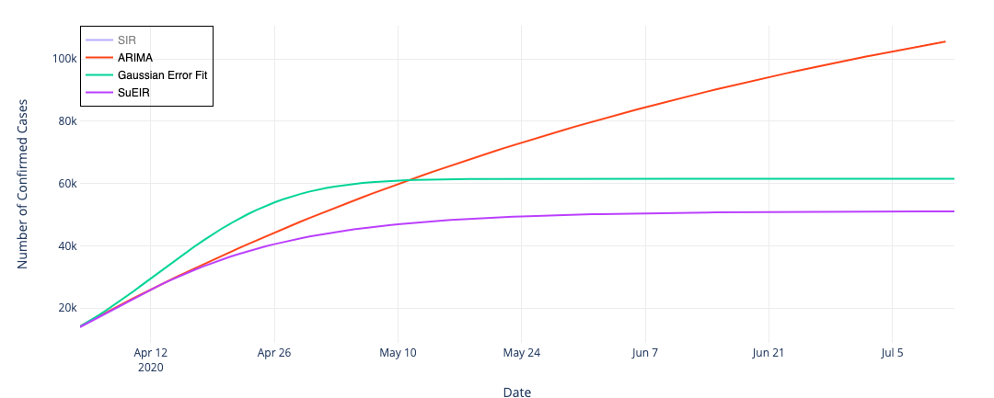
Challenge
Build a predictive model of the spread of Covid-19
The model can be purely mechanistic, purely statistical, or a combination of both
Fit and test your model
Optional:
Estimating R_{t}
Modelling interventions

Slide 3
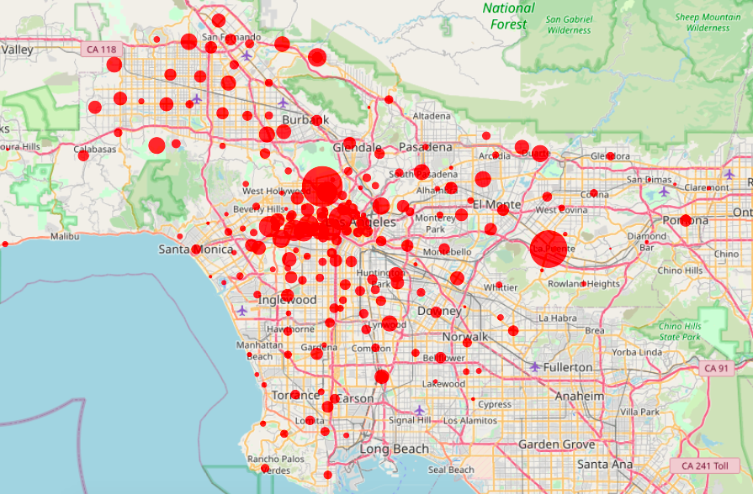
Data
You will test your model on three datasets:
International case/mortality data
US county case/mortality data
LA neighborhood case data
Data will be found in the Hackathon Google drive, which will be shared with you after this morning’s presentations

Slide 4

Judging
Creativity (30 pts)
Don’t reinvent the wheel, but create something unique
Rigor (40 pts)
Demonstrate how you’ve tested your model
How have you fit any model parameters, if relevant
Summary statistics that capture model fit to data
Presentation (10 pts)
3 minutes, 3 slides
Explain and visualize your model
Additional (4th) slide for citations
Analysis/Reflection (20 pts)
What predictions does your model make about Covid-19 in the short, medium, and long term?
What features of reality does your model capture? Where does it fail?
How well does your model perform on each dataset?

Slide 5
Deliverables
Code
A folder containing your code, preferably (though not necessarily) sent as Jupyter Notebooks (.ipynb files)
Code must be ready to be executed on the datasets
Your code must be commented
Slides
Maximum of three presentation slides, plus one citation slide
Email the deliverables together, as attachments, to rwolff@g.ucla.edu
All materials are due 4:30pm Sunday (7/19)
Presentations will begin at 5pm

Slide 6
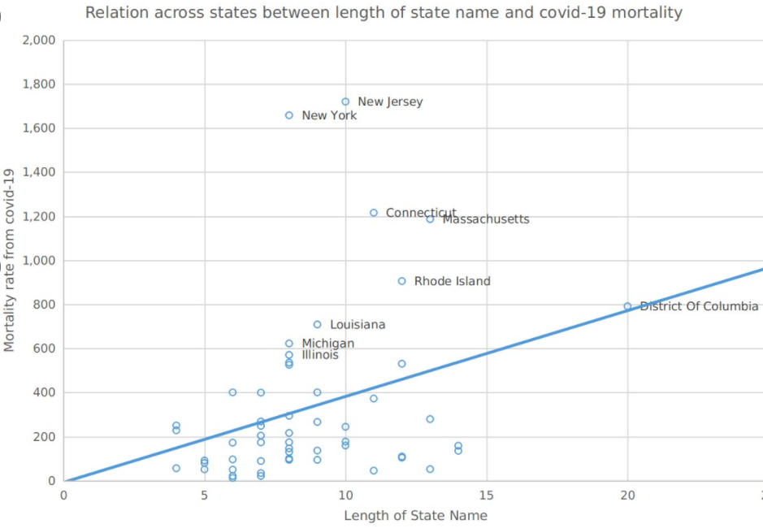
(Have fun with it)

Slide 7
Questions?

